Slide 1
Presentation brief for MCT’s
Title of presentation | "No-code" Machine Learning with Designer
Presentation length | 120 minutes (including labs)
Audience | Data Scientists planning to operate machine learning workloads on Azure
Purpose | Introduce Designer and how to use it to build a training pipeline Describe how to use Designer to publish an inference pipeline and deploy it as a service
(think) Student key takeaways | Designer enables rapid machine learning model development with no code Designer pipelines can be punlished as web services and consumed by applications
(feel) Student desired mindset | Confident creating and running training pipelines in Designer Confident deploying and consuming Designer inference pipelines as services
(do) Student outcomes | Create a training pipeline in the Designer interface Create an inference pipeline from a training pipeline Deploy an inference pipeline as a service and consume it from a client application
More information | For course feedback, please use the MCT Forums

Slide 2

Module 2: "No-code" Machine Learning with Designer

Slide 3
Agenda
Training Models with Designer
Publishing Models with Designer

Slide 4



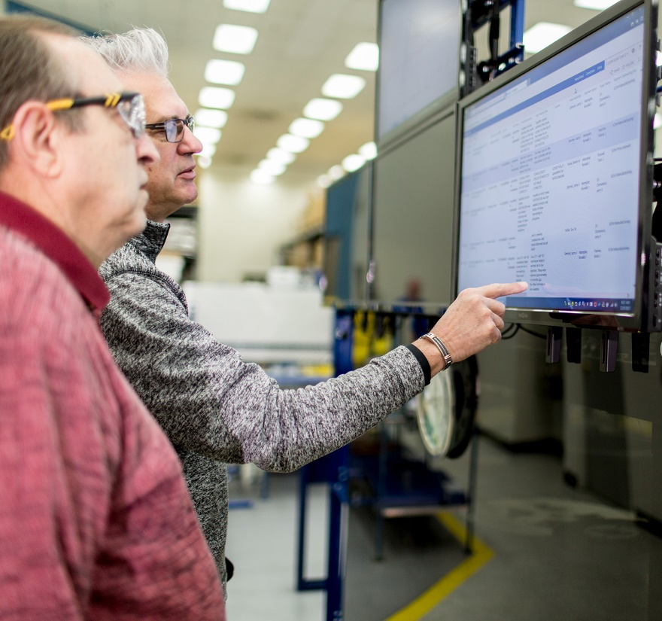









Lesson 1
Training Models with Designer
Data
Cloud
AI

Slide 5
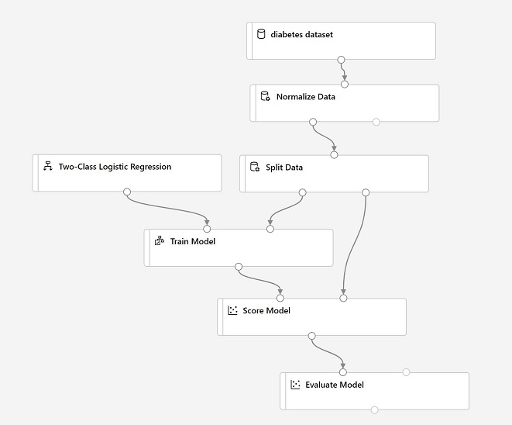
What is Azure Machine Learning Designer?
Drag-and-Drop Interface for:
Preparing data and training models
Publishing models as services

Slide 6
Designer Pipelines and Modules
Dataset
Module
Pipeline

Slide 7
Training, Scoring, and Evaluating Models
1. Algorithm
Classification, Regression, Clustering
3. Score
Predict from test data
2. Train
Fit model for specified label
4. Evaluate
model-specific metrics

Slide 8
Custom Code Modules
Apply SQL Transformation | Use a SQL statement to process up to three input tables
Execute Python Script | Implement a custom Python function to process up to two dataframes
Create Python Model | Implement a custom Python model in place of a built-in algorithm
Execute R Script | Implement a custom R function to process up to two dataframes

Slide 9
Lab 2A
Creating a Training Pipeline with the Azure ML Designer
https://aka.ms/msl-dp100

Slide 10
Lesson Review
Complete the Review Questions

Slide 11
Lesson 2
Publishing Models with Designer
Data
Cloud
AI

Slide 12
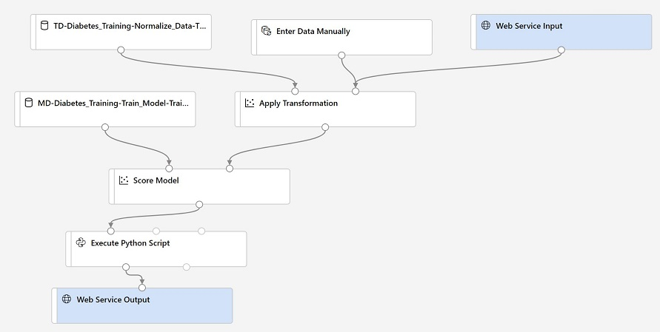
What is an Inference Pipeline?
A data flow defining a web service for using the trained model
A Web Service Input defines the input data schema
Transformations based on training data are encapsulated in datasets
The trained model is encapsulated in a dataset
A Web Service Output defines the output data schema
You may want to modify the pipeline before deploying its as a web service

Slide 13
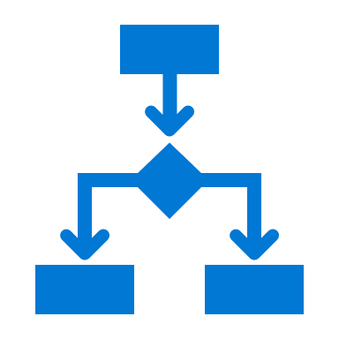





Publishing a Service Endpoint
Deploy a Real-Time Pipeline:
Requires Azure Kubernetes Services Inference Compute
Submit new data to HTTP endpoint for immediate results
Publish a Batch Pipeline
Requires Azure Machine Learning Training Compute
Initiate pipeline experiment run through HTTP endpoint
Results saved in run output

Slide 14
Consuming a Service Endpoint
View endpoints in Azure Machine Learning studio
Use starter code to build client applications
data = {"Inputs": {"input0":[{'feature1': "123", 'feature2': "99",},],},
"GlobalParameters": {}}
body = str.encode(json.dumps(data))
url = 'http://10.0.0.1:80/api/v1/service/diabetes_predictor/score'
api_key = 'a1234567890x'
headers = {'Content-Type':'application/json',
'Authorization':('Bearer '+ api_key)}
req = urllib.request.Request(url, body, headers)
response = urllib.request.urlopen(req)
result = response.read()

Slide 15
Lab 2B
Deploying a Service with the Azure ML Designer
https://aka.ms/msl-dp100

Slide 16
Lesson Review
Complete the Review Questions

